Slide 1
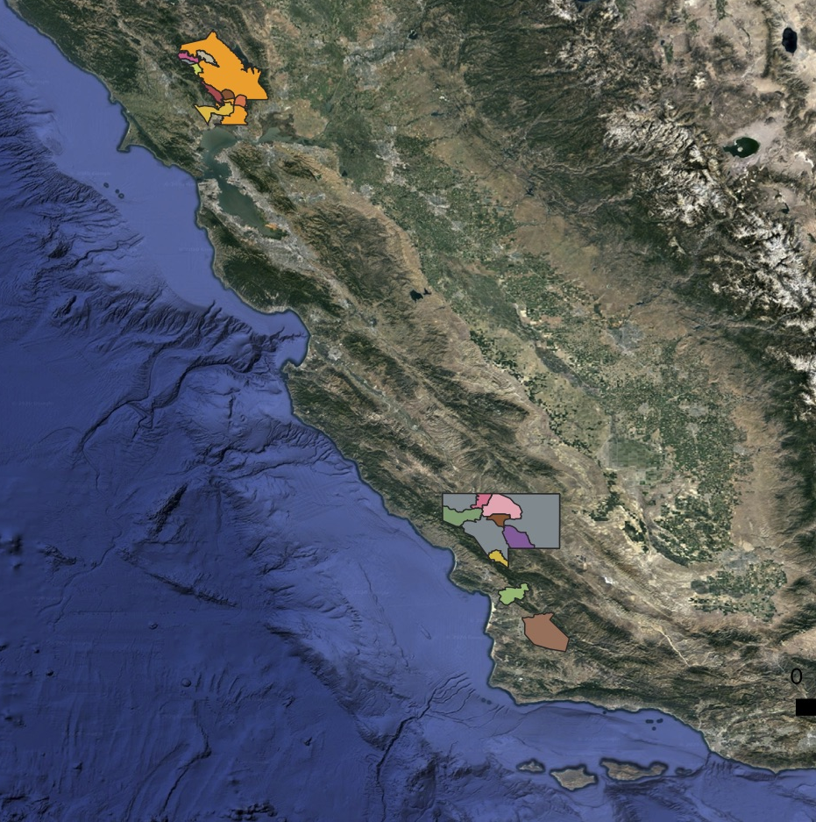
Napa Valley and Paso Robles are the most lucrative wine regions in the US.
Organized by AVAs (American Viticulture Areas) based on grape and regional characteristics.
However, Climate change (see appendix 1) is threatening these regions
PROBLEM: AVAs crafted in the 1960s lack this info and may not be sustainable.
By: Colleen Young

Slide 2
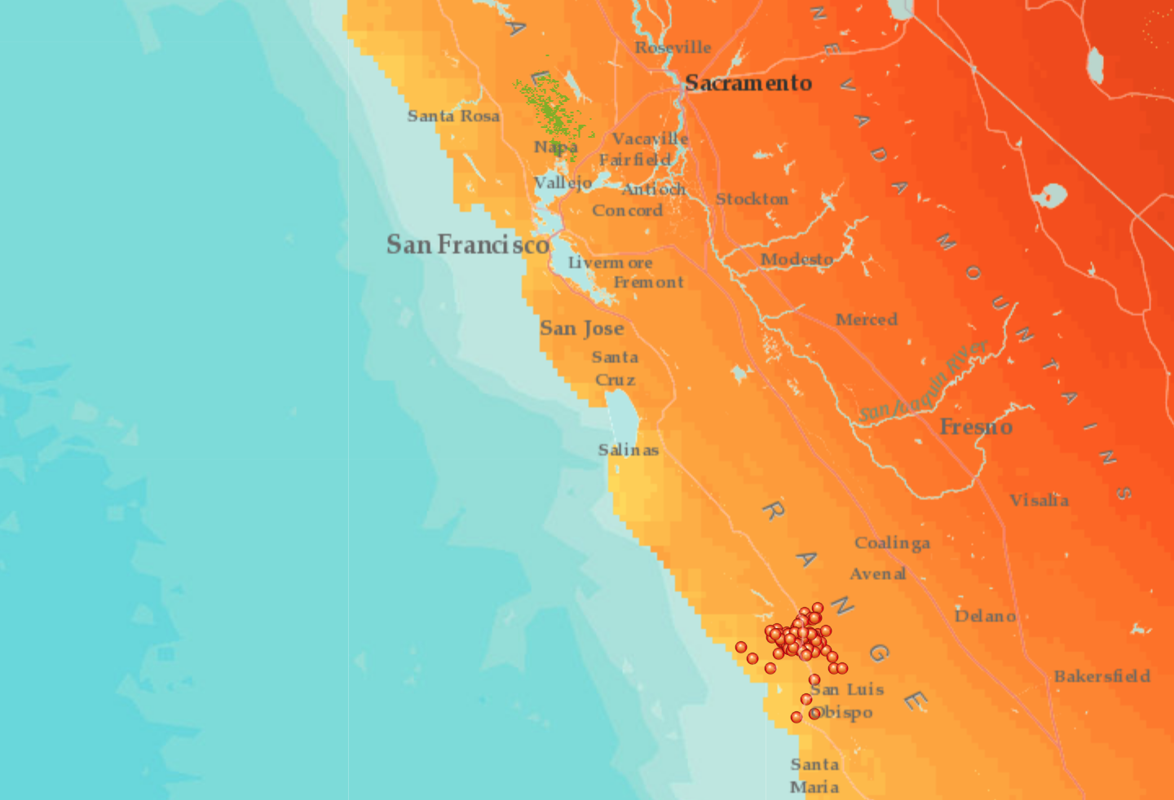
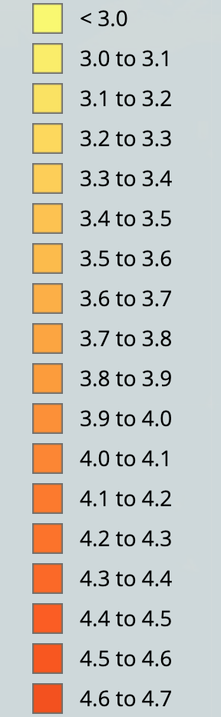
Both Napa Valley and Paso Robles have projected increasing temperature in 2050 (see appendix 2 & 3)
SUPPORTING DATA

Slide 3
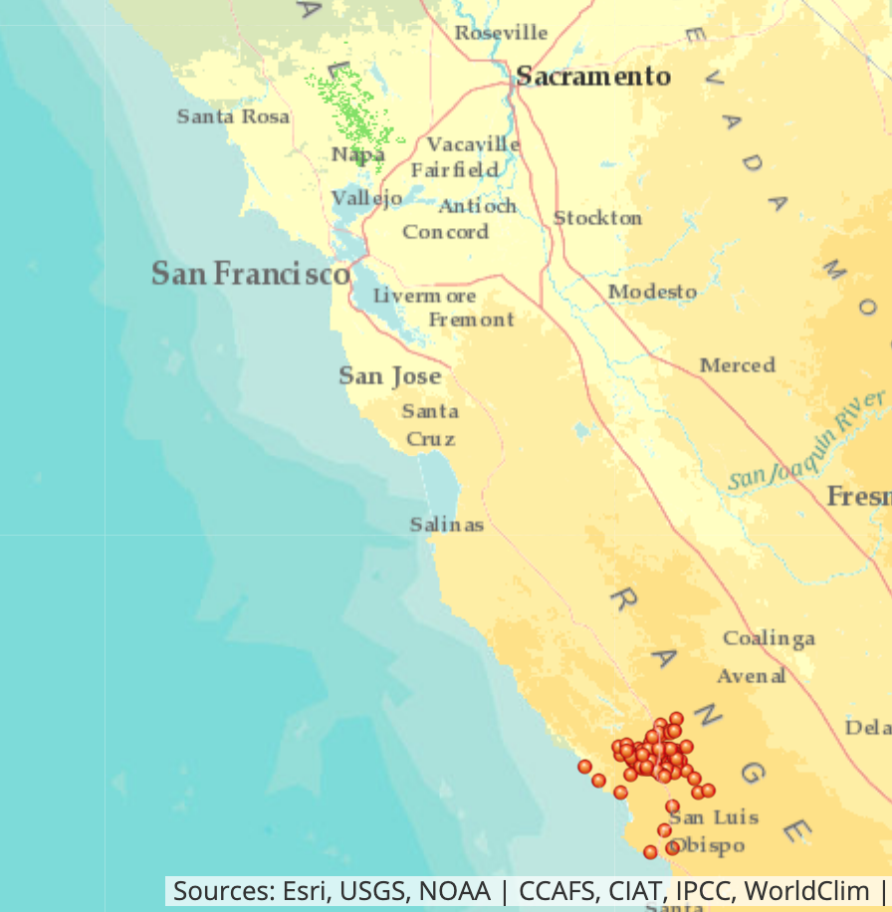
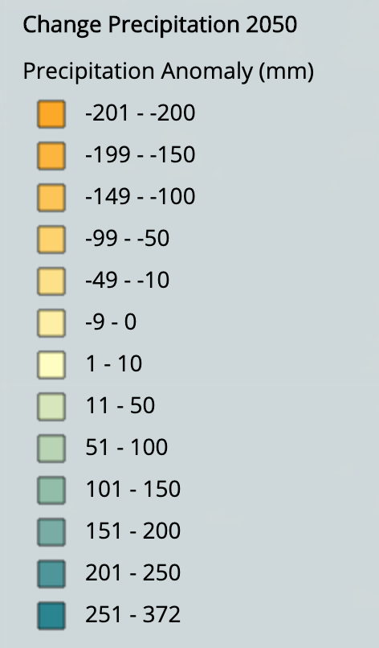
Napa Valley has increasing precipitation (+1-10 mm). Paso Robles has decreasing precipitation (-50-100 mm) But both have seasonal changes as well (see appendix 4 and 5).
SUPPORTING DATA

Slide 4
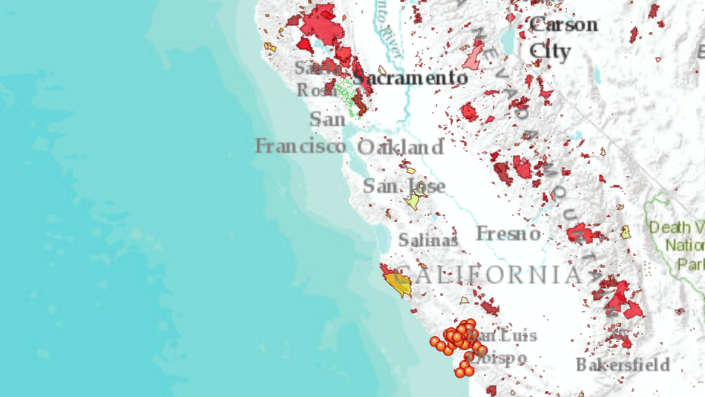
SUPPORTING DATA
Napa Valley has significantly higher fire risk, with increased proximity to historical fires and old redwood forests, resulting in increased historical fire perimeters.
Paso Robles has had far fewer fires in the past 20 years, even though they have less precipitation and higher temps.

Slide 5
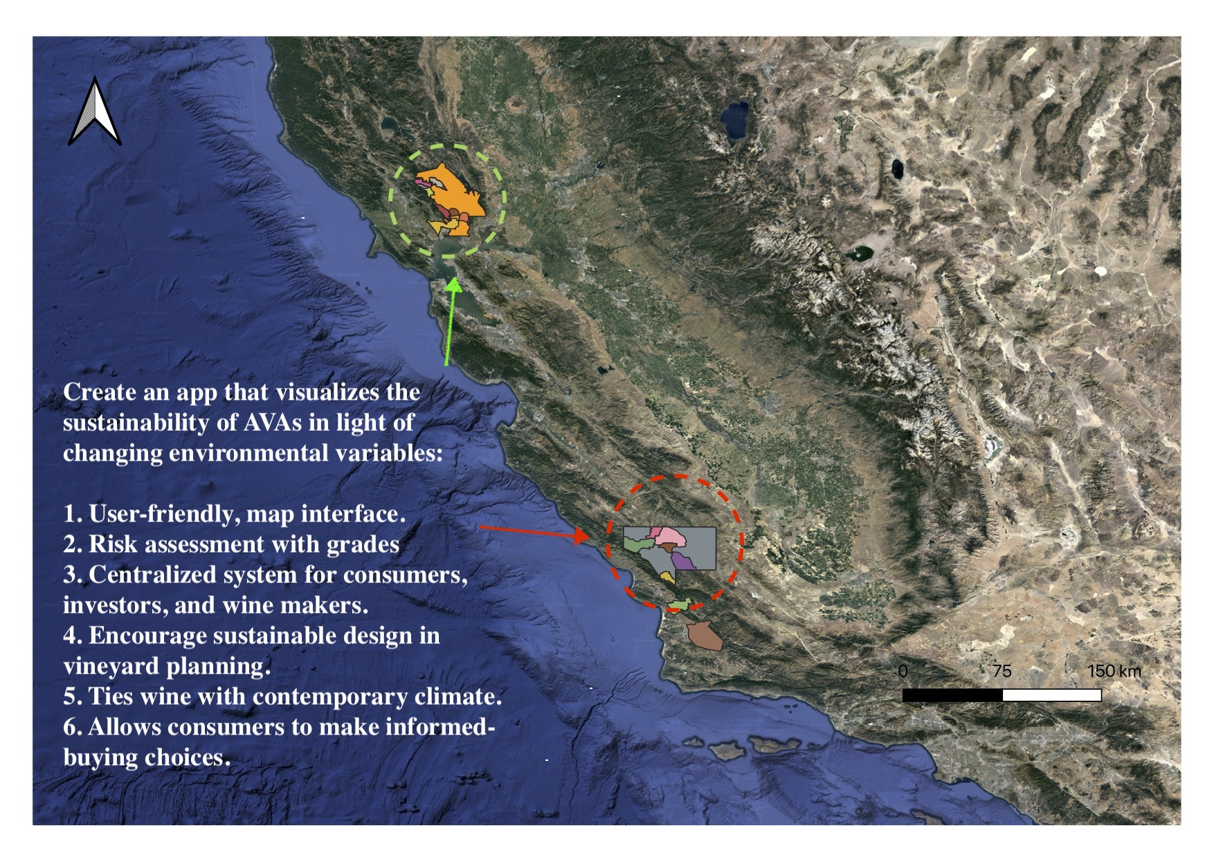
Code regions from green to red based on the degree of risk of crop failure and yield loss within their AVAs. Sustainable AVAs Take trends from 1950-1975 as baseline to assess today's AVAs and develop risk coding system.
SOLUTION

Slide 6
APPENDIX

Slide 7
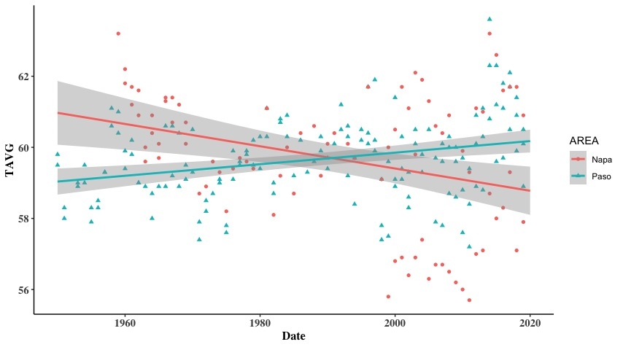
Appendix 1
Notes:
Average temperature is clearly changing in both regions. Further, Napa temperature is more variable in recent years making predictions difficult.

Slide 8
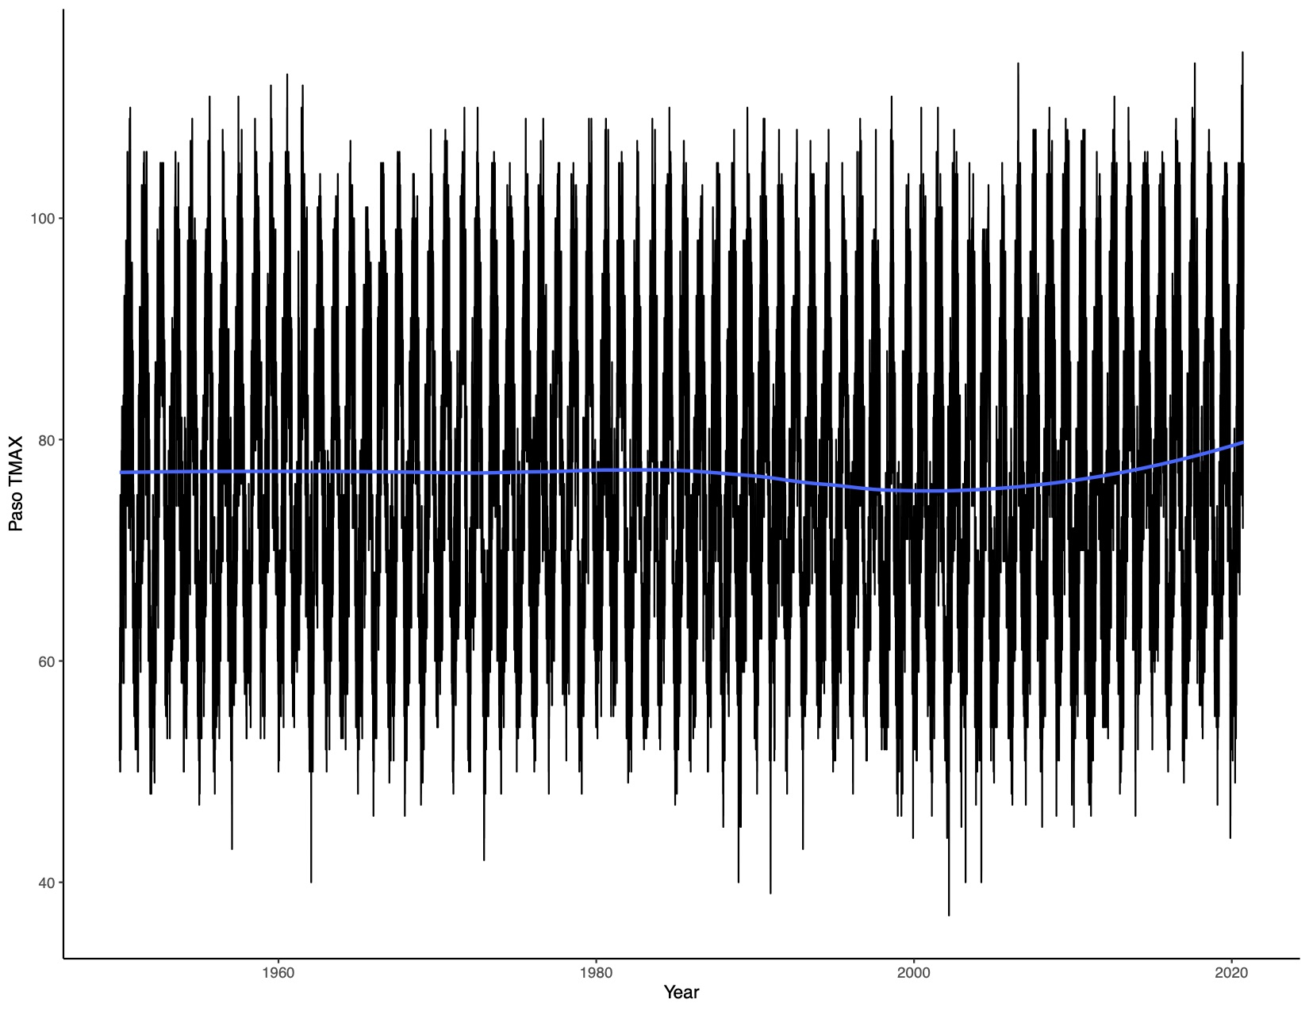
Appendix 2
Paso Robles daily time series of 160,000 data to assess changing max temperature trends. Loess regression line indicates increasing temperature in recent years.

Slide 9
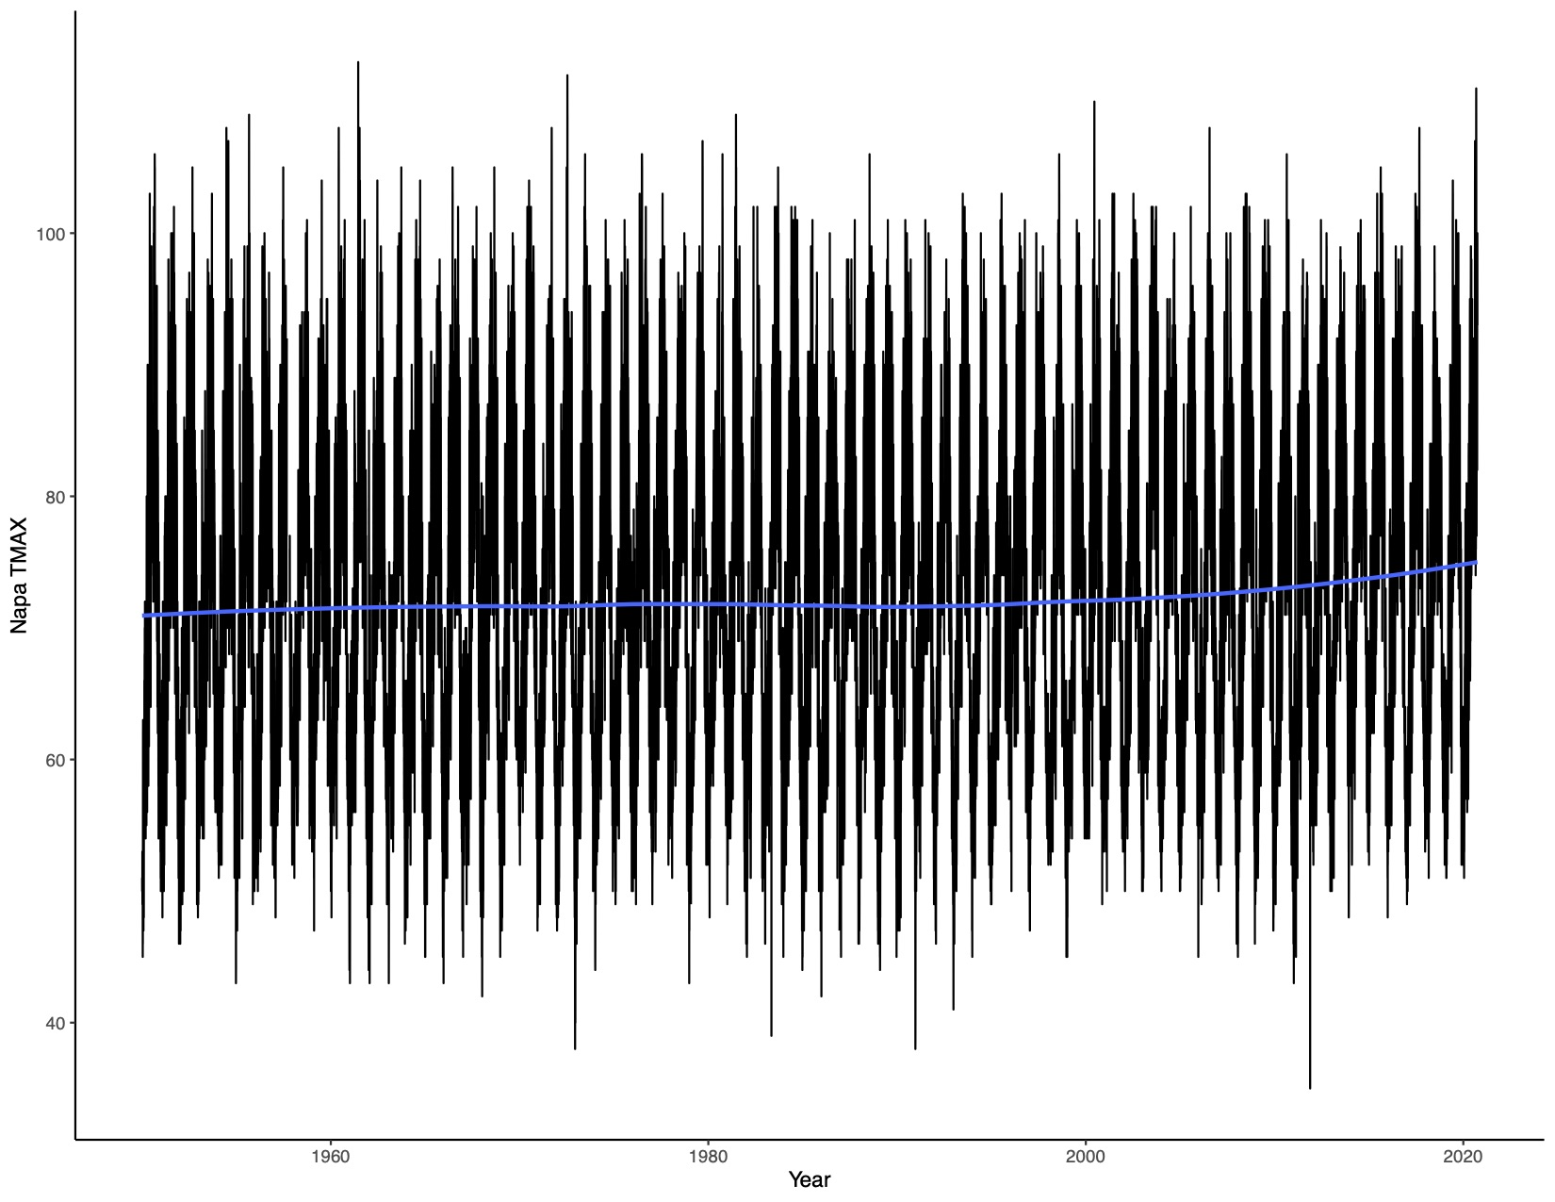
Appendix 3
Napa Valley daily time series of 160,000 data to assess changing max temperature trends. Loess regression line indicates increasing temperature in recent years.

Slide 10
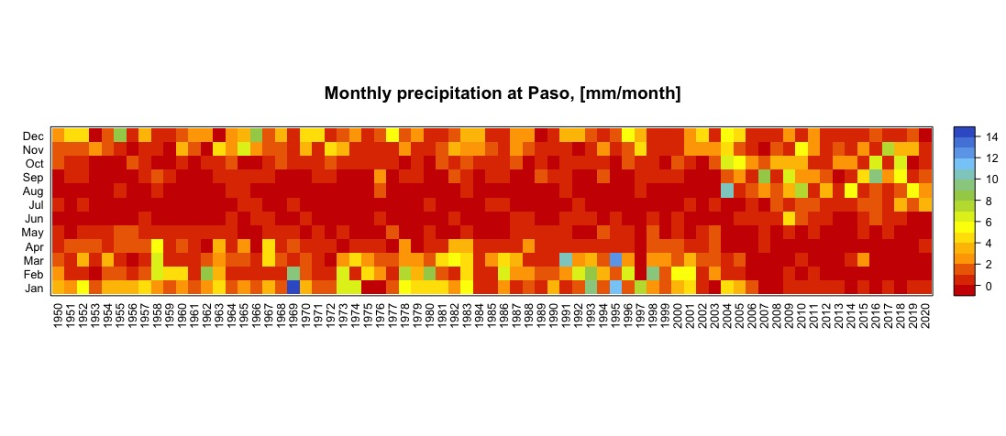
Appendix 4
Paso robles monthly time series of 13,333 data to assess changing seasonal precipitation trends. Seasonality is changing for paso with significantly drier winter-spring months, resulting in less soil hydration in summer months.

Slide 11
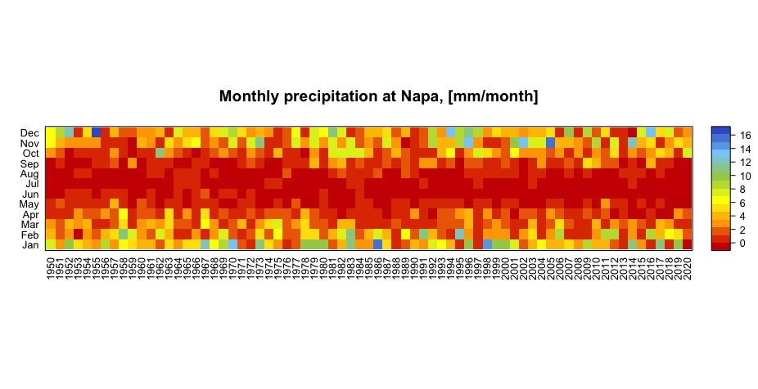
Appendix 5
Napa Valley monthly time series of 13,333 data to assess changing seasonal precipitation trends. Seasonality is remaining roughly the same for Napa.

